Slide 1
Project presentation
SD Team gray
Hong chaemin
Park seojin
Cho moohyun

Slide 2
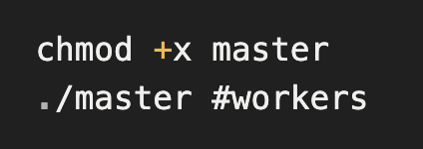
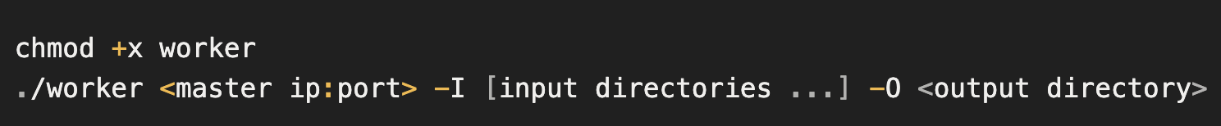
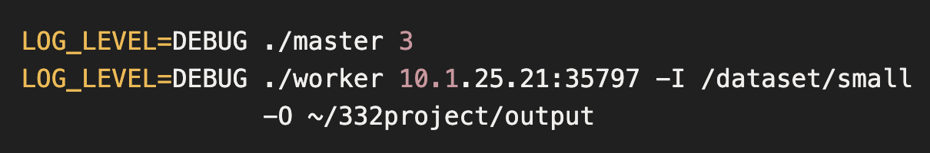
Command lines for running
Run Master/Worker (by scripts)
Structured logging (SLF2J, Logback)
- Set Log_Level by environment variable (default: INFO)
- e.g.
Notes:
Demo – 저희는 Fault tolerance에 대해 어떤 시점에 몇개 노드를 끊더라도 동작하도록 설계하였는데 조금 stressful한 test demo를 보여드리겠습니다.
Worker registration중에 끊고 sampling 중에 끊고.. 하더라도 다시 다 실행시켰을 때 잘 종료되는 것을 보실 수 있습니다.

Slide 3
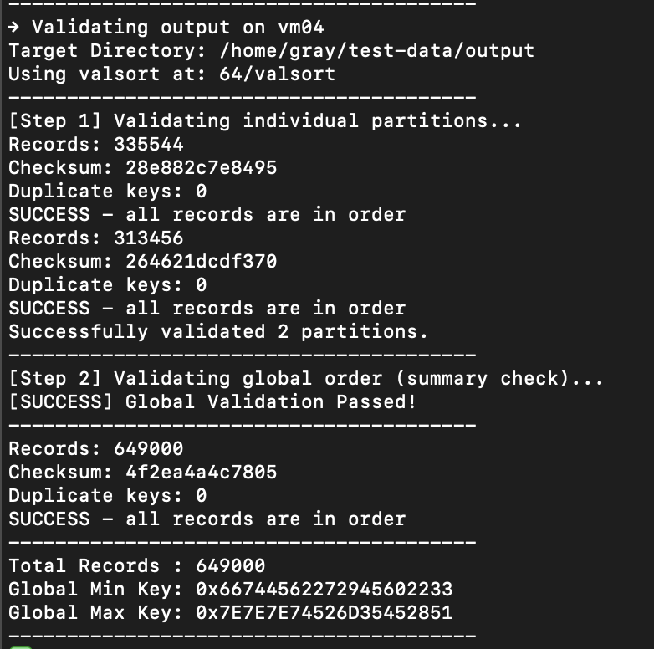
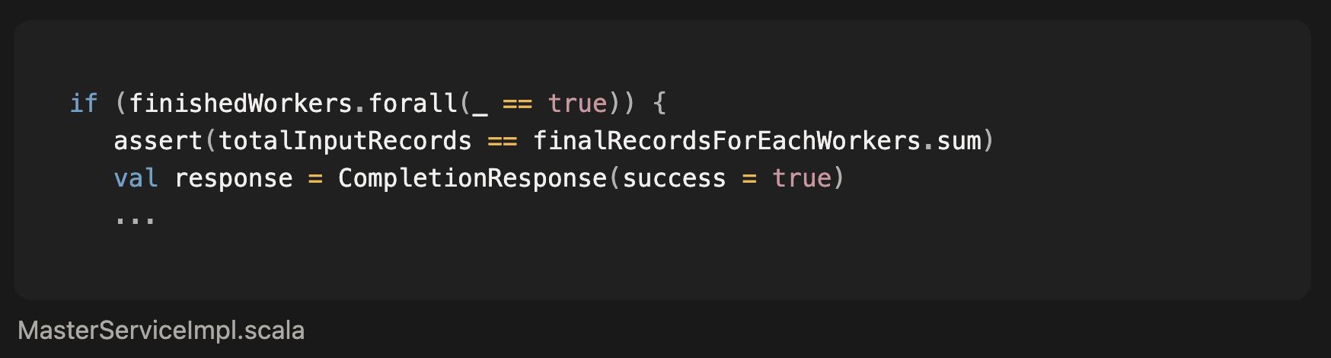
Experimental results
Execution time
- small
20 7.389s
18 5.107s
4 3.727s
- big
20 13m 16.82s
18 27.988s
7 10.124s
4 8.101s
- Large
20
4 2m 5.182s
Correctness
1. Does the master print a sequence of workers? | Yes
2. Is the output sorted in each worker? | Yes
3. # of records in the input == # of records in the output? | Yes
4. Fault tolerance | Yes
2. Valsol for each worker – Check output ordering
Assertion code in merge phase
- Guarantee each key is within the pivot range
3. Assertion code in completion phase
- Guarantee the number of records is conserved

Slide 4
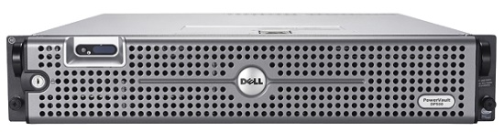

FileId – how worker knows own needed File
Pull-based shuffle
File name for shuffle: file_#i_#j_#k.dat (i: worker number, j: partition, k: index)
Each worker reports own file Id set (i, j, k) to the Master and receives the complete file list from all workers.
Master
Blue: partition 1
Red: partition 2
(1,1,0),(1,1,1),
(1,2,0),(1,2,1)
(2,1,0),(2,1,1),
(2,2,0),(2,2,1)
(1,1,0),(1,1,1),
(1,2,0),(1,2,1),
(2,1,0),(2,1,1),
(2,2,0),(2,2,1)
Worker1
Worker2
(1,2,0)
File_1_2_0
File_1_1_0
File_1_1_1
File_1_2_0
File_1_2_1
File_2_1_0
File_2_1_1
File_2_2_0
File_2_2_1

Slide 5
Final architecture
Master
Master State
Worker
Other Worker
Worker Info Array
Request Status Tracker per RPC Method
Server
Server
Register all workers.
If a worker register again,
then reset its worker info
Worker Info (Ip, Port, input dirs)
Registration
All Worker Info (Worker Id, Ip, Port)
Worker Id, Sampled Data
Sampling
Collect sample data and select pivots.
If a worker requests again, then just send pre-calculated pivots.
Pivots
Sort & Partition
Worker Id, FileIds (i,j,k)
Collect all FileIds.
If a worker request again, then just send all FileIds without adding its FileIds
Report FileId
All FileIds (i,j,k)
FileId (i,j,k)
Stream file data corresponding to the received FileID
Shuffle
Remaining files
Fail
data
Send current all worker info
Request Worker Info
Success
All Worker Info (Worker Id, Ip, Port)
Merge
If a worker disconnects after reporting completion, its report is cancelled.
Shutdown
Worker Id
Request
Completion
Response
Initial Response: Master waits for all requests
Subsequent Responses: Immediately
Shutdown
Response (Immediate)

Slide 6
Final architecture
Design for Fault Tolerance
Master
Master State
Worker
Other Worker
Worker Info Array
Request Status Tracker per RPC Method
Retry Handling
Server
(2.2.2.102, 1234, “input”)
Server
Register all workers.
If a worker register again,
then reset its worker info
Worker Info (Ip, Port, input dirs)
Registration
All Worker Info (Worker Id, Ip, Port)
Worker Id, Sampled Data
Worker Info
Id: 2
Ip: “2.2.2.102”
Port: 1111
Sampling
Collect sample data and select pivots.
If a worker requests again, then just send pre-calculated pivots.
Key
Ip: “2.2.2.102”
Input dirs.: Set(“input”))
Pivots
Sort & Partition
Worker Id, FileIds (i,j,k)
1234
Collect all FileIds.
If a worker request again, then just send all FileIds without adding its FileIds
Report FileId
All FileIds (i,j,k)
Tracker for FileId
FileId (i,j,k)
Stream file data corresponding to the received FileID
O | O | O | X
Shuffle
Remaining files
Fail
data
Send current all worker info
Request Worker Info
Success
All Worker Info (Worker Id, Ip, Port)
Disconnect Handling
Tracker for completion
Merge
X | X | X | X
Shutdown
If a worker disconnects after reporting completion, its report is cancelled.
O
Worker Id
2
Request
Completion
Response
Initial Response: Master waits for all requests
Subsequent Responses: Immediately
Shutdown
Response (Immediate)

Slide 7
Leverage multi-core
Sort & Partition
Shuffle
Merge
input0
input1
File_1_1_0
File_1_2_0
File_1_1_1
File_1_2_1
# of threads = min(# of cores, usable memory size / max file size)
# of threads = # of workers
# of threads = # of cores (if single-pass merge is not possible)
1 (if single-pass merge is possible)

Slide 8
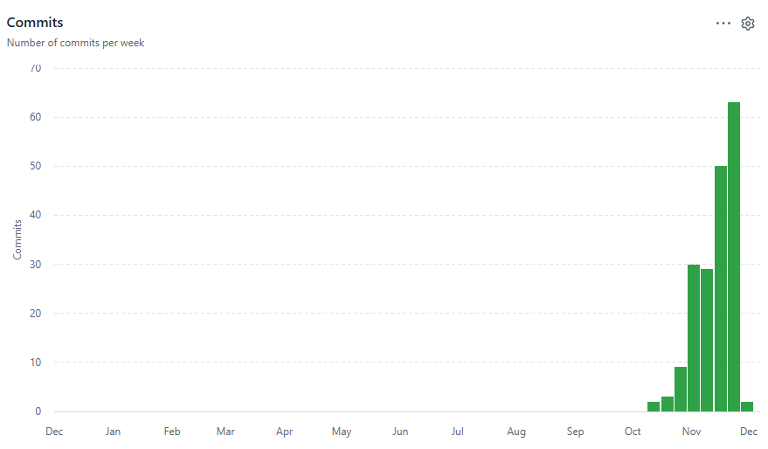
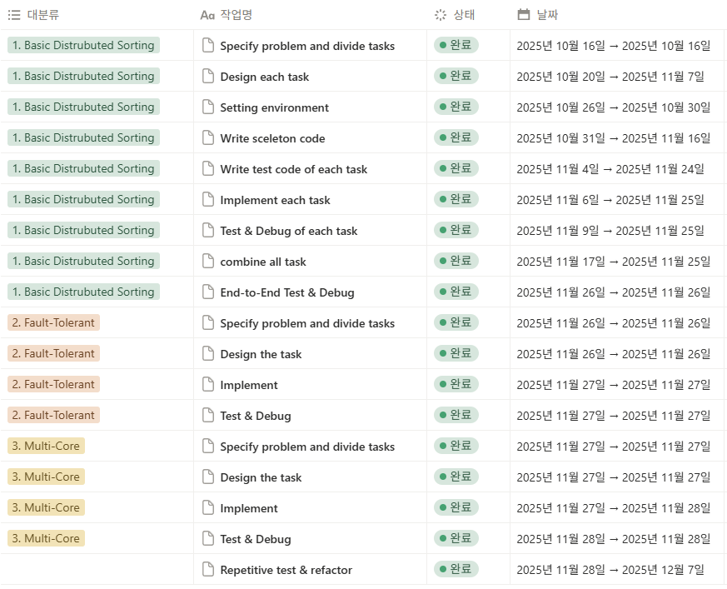
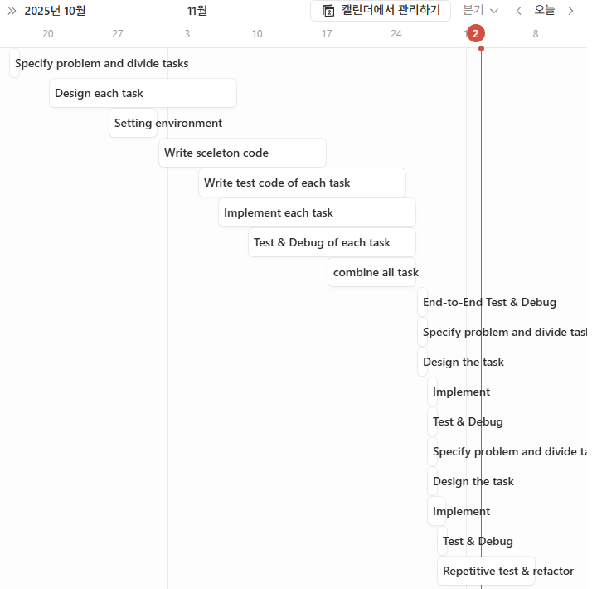
Overall progress

Slide 9
Why our project was successful
Surgical Team model
  Chief Progammer - Chaemin
    Designed project directory structure
    integrated the entire pipeline
Minimized Communication Overhead
  Shared only essential information
    Common understanding of the project
    Clear scope and output data structure for each phase
Test-Driven Development for core features
  Before integration, every member ensured correctness of their own phase using pre-developed test
  -> Almost zero debugging during integration
  Co-pilots
    managed Shuffle Phase - Seojin
    managed Sort & Partition Phase - Moohyun

Slide 10
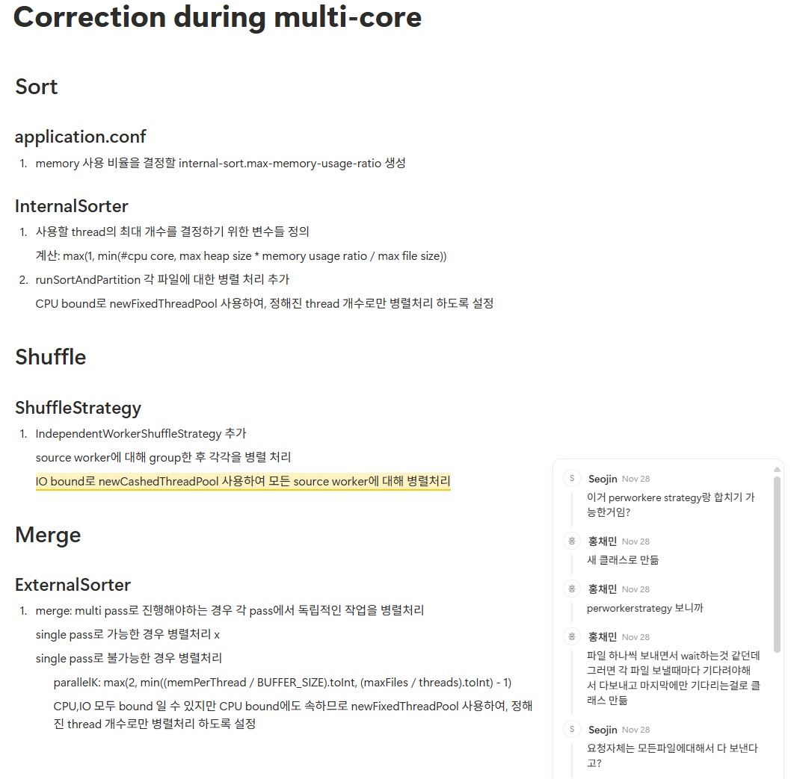
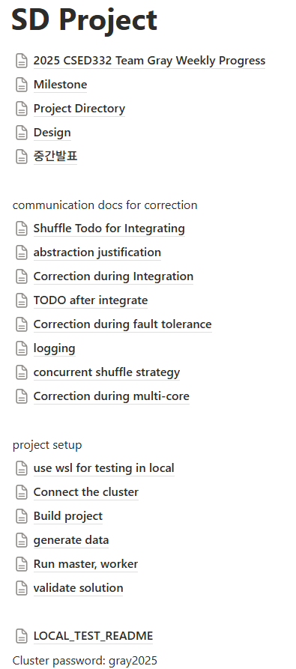
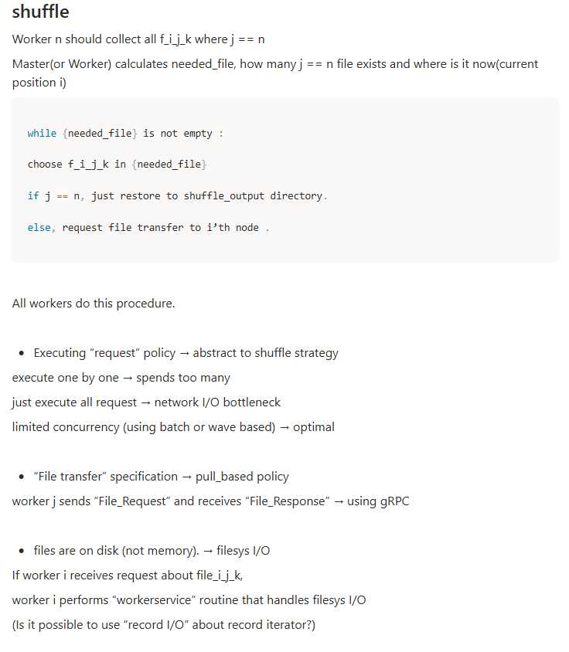
How we communicated
Notion - documentation for common understanding
Weekly offline meeting – consensus of design
https://morning-drawbridge-ada.notion.site/SD-Project-2a8be201a70880d1a5e1f13ccfaa5049?source=copy_link

Slide 11
Thank you for listening

Slide 12
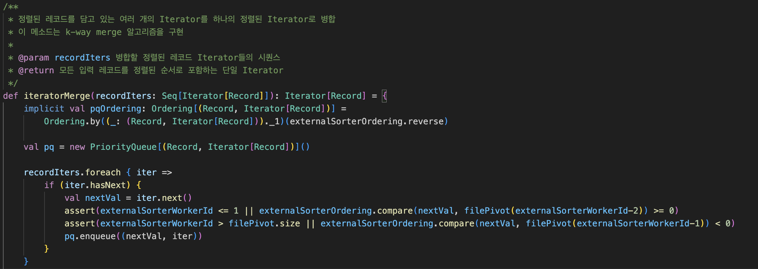
BackupSlide

Slide 13
Final architecture
Design for Fault Tolerance
Master
Master State
Worker
Other Worker
Worker Info Array
Request Status Tracker per RPC Method
Server
Ip: 2.2.2.103, port: 1234
Server
Register all workers.
If a worker register again,
then reset its worker info
Worker Info (Ip, Port, input dirs)
Registration
Registration
All Worker Info (Worker Id, Ip, Port)
Worker Id, Sampled Data
Sampling
Collect sample data and select pivots.
If a worker requests again, then just send pre-calculated pivots.
Pivots
Sort & Partition
Sort & Partition
Worker Id, FileIds (i,j,k)
Collect all FileIds.
If a worker request again, then just send all FileIds without adding its FileIds
Report FileId
All FileIds (i,j,k)
FileId (i,j,k)
Stream file data corresponding to the received FileID
Shuffle
Remaining files
Fail
data
Send current all worker info
Request Worker Info
Success
All Worker Info (Worker Id, Ip, Port)
… Worker Info (3, 2.2.2.103, 1111) …
… Worker Info (3, 2.2.2.103, 1234) …
Merge
If a worker disconnects after reporting completion, its report is cancelled.
Shutdown
Worker Id
Request
Completion
Response
Initial Response: Master waits for all requests
Subsequent Responses: Immediately
Shutdown
Response (Immediate)

